Slide 1
Retaining Disadvantaged Young People in Work
IPA Employee Voice Hub
May 2023

Slide 2



Introducing
Catherine Hogan
Future Voices Ambassador and Degree Apprentice at Mind
Eleanor Marsea
Strategy Manager at Youth Futures Foundation

Slide 3
Youth Futures Foundation
We are the What Works Centre for youth employment.
We want employment gaps to be reduced so that young people facing the greatest challenges can find and keep good quality jobs.
There was a 13% increase in NEET young people in the last year
Care leavers are four times more likely to be NEET
In the year to June 2022, unemployment rates were highest for Black young people at 21%, compared to 9% for their White peers.
The proportion of NEET young people is highest amongst those from Pakistani or Bangladeshi backgrounds
Did you know…
matching the NEET rates of Germany could add £38bn to our economy.

Slide 4






Youth Futures Foundation
Giving Grants
To organisations that provide employment support to young people so that we can generate high quality evaluations
Generating Evidence
Through conducting and using high-quality research
Influencing Policy Change and Employer Practice
Driving evidence-based change in policy and working with employers and practitioners to improve practice.

Slide 5

Our Research
Two “rapid evidence assessments” with Centre for Evidence Based Management
Partnership with Chartered Institute of Personnel and Development (CIPD)
Summarising evidence from high quality evaluations of employer practice relating to disadvantaged young people:
  Recruitment & selection
  Retention & inclusion
Available for free online, each with a summary from CIPD
Notes:
https://www.cipd.co.uk/Images/retaining-disadvantaged-young-people_tcm18-109092.pdf

Slide 6
What factors do you think influence young people to stay or leave a workplace?

Slide 7
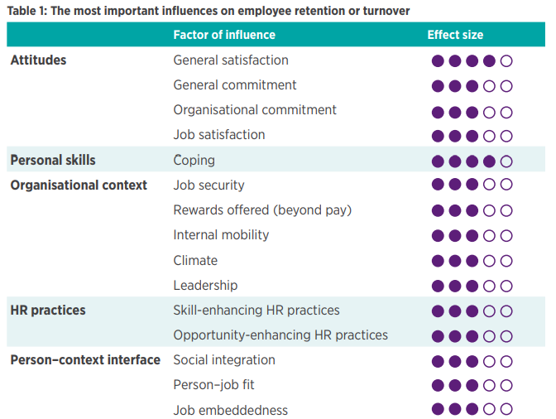
What makes people stay?

Slide 8

Barriers to progression: marginalised young people
Unequal access to information on career development opportunities
Fewer positive social interactions with co-workers
Biased assessment and selection decisions

Slide 9
Catherine: Barriers to progressing
Stereotypes around work experience
Underestimation of skills and unique talents young people bring
Remote working
Access to mentor or coach
Difficulty acquiring management experience
Impact of Covid-19
Less than 1/3 of young people believe employers are supportive of hiring young people*
*Youth Voice Census 2022

Slide 10
The role of managers in retention and inclusion. What helps?
Use participatory decision-making
Be an authentic leader
Adopt a transformational leadership
Style
Recommendations for practice:
1. Build awareness of managers’ role in fostering inclusion
2. Assess where managers currently stand
3. Offer development for leaders on inclusive behaviours and leadership styles

Slide 11

Catherine: The role of managers
Understanding personal development needs within apprenticeship
Support with networking
Trust with responsibility
Open dialogue for wellbeing – Wellness Action Plans
Supportive of taking annual leave

Slide 12
Which age group do you think has the highest rates of job hopping?

Slide 13


Internal networks
Leverage diversity and foster inclusion
Employees who share a common characteristic, trait or interest
Emotional support, safe space, representation, accomplish goals or projects.
Although popular, evidence is lacking on the association between networks and people’s intention to leave an organisation

Slide 14
Catherine: Internal networks
Established Young Staff Network
Purpose of network is peer support and supporting organizational initiatives
Opportunities for development within network
Role of champions to support the network
“The peer support of the network has been a game-changer for my experience of being an employee at Mind. It feels like a really safe space to share the highs and lows of navigating the organisation and generally being a young staff member”.

Slide 15
What diversity training has your organisation offered in the last year?

Slide 16
Diversity training
Diversity training does work… in the short term
People remember the information learnt...
But often behaviours and attitudes revert over time
Recommendations for practice:
Diversity training shouldn’t be standalone and part of a wider set of initiatives
Dedicate enough time to practise skills following training
Make diversity training compulsory

Slide 17
Thank you
Any questions?

Slide 18
Links
https://www.cipd.co.uk/Images/retaining-disadvantaged-young-people_tcm18-109092.pdf
https://youthfuturesfoundation.org/our-work/ignite/employer-advisory-board/
Contact:
Eleanor.Marsea@youthfuturesfoundation.org

